Slide 1
Chapter 17 - Networking
Outline
17.1 Introduction
17.2 Manipulating URLs
17.3 Reading a File on a Web Server
17.4 Establishing a Simple Server Using Stream Sockets
17.5 Establishing a Simple Client Using Stream Sockets
17.6 Client/Server Interaction with Stream Socket Connections
17.7 Connectionless Client/Server Interaction with Datagrams
17.8 Client/Server Tic-Tac-Toe Using a Multithreaded Server
17.9 Security and the Network
17.10 DeitelMessenger Chat Server and Client
17.10.1 DeitelMessengerServer and Supporting Classes
17.10.2 DeitelMessenger Client and Supporting Classes

Slide 2
Chapter 17 - Networking
Outline (cont.)
17.11 (Optional) Discovering Design Patterns: Design Patterns Used in Packages java.io and java.net
17.11.1 Creational Design Patterns
17.11.2 Structural Design Patterns
17.11.3 Architectural Patterns
17.11.4 Conclusion

Slide 3
17.1 Introduction
Networking package is java.net
  Socket-based communications
    Applications view networking as streams of data
    Connection-based protocol
    Uses TCP (Transmission Control Protocol
  Packet-based communications
    Individual packets transmitted
    Connectionless service
    Uses UDP (User Datagram Protocol)

Slide 4
17.2 Manipulating URIs
HyperText Transfer Protocol (HTTP)
  Uses URIs (Uniform Resource Identifiers) to locate data
    URIs frequently called URLs (Uniform Resource Locators)
    Refer to files, directories and complex objects

Slide 5
SiteSelector.html
1 <html>
2 <title>Site Selector</title>
3 <body>
4 <applet code = "SiteSelector.class" width = "300" height = "75">
5 <param name = "title0" value = "Java Home Page">
6 <param name = "location0" value = "http://java.sun.com/">
7 <param name = "title1" value = "Deitel">
8 <param name = "location1" value = "http://www.deitel.com/">
9 <param name = "title2" value = "JGuru">
10 <param name = "location2" value = "http://www.jGuru.com/">
11 <param name = "title3" value = "JavaWorld">
12 <param name = "location3" value = "http://www.javaworld.com/">
13 </applet>
14 </body>
15 </html>

Slide 6
SiteSelector.java
Lines 20-63
Lines 23-24
Line 27
Lines 31-32
1 // Fig. 17.2: SiteSelector.java
2 // This program uses a button to load a document from a URL.
3
4 // Java core packages
5 import java.net.*;
6 import java.util.*;
7 import java.awt.*;
8 import java.applet.AppletContext;
9
10 // Java extension packages
11 import javax.swing.*;
12 import javax.swing.event.*;
13
14 public class SiteSelector extends JApplet {
15 private Hashtable sites; // site names and URLs
16 private Vector siteNames; // site names
17 private JList siteChooser; // list of sites to choose from
18
19 // read HTML parameters and set up GUI
20 public void init()
21 {
22 // create Hashtable and Vector
23 sites = new Hashtable();
24 siteNames = new Vector();
25
26 // obtain parameters from HTML document
27 getSitesFromHTMLParameters();
28
29 // create GUI components and layout interface
30 Container container = getContentPane();
31 container.add( new JLabel( "Choose a site to browse" ),
32 BorderLayout.NORTH );
33
Method init initializes applet
Create HashTable and Vector objects
Obtain HTML parameters from HTML document that invoked applet
Add JLabel to applet

Slide 7
SiteSelector.java
Lines 36-58
Lines 41-54
Lines 60-61
34 siteChooser = new JList( siteNames );
35
36 siteChooser.addListSelectionListener(
37
38 new ListSelectionListener() {
39
40 // go to site user selected
41 public void valueChanged( ListSelectionEvent event )
42 {
43 // get selected site name
44 Object object = siteChooser.getSelectedValue();
45
46 // use site name to locate corresponding URL
47 URL newDocument = ( URL ) sites.get( object );
48
49 // get reference to applet container
50 AppletContext browser = getAppletContext();
51
52 // tell applet container to change pages
53 browser.showDocument( newDocument );
54 } // end method valueChanged
55
56 } // end anonymous inner class
57
58 ); // end call to addListSelectionListener
59
60 container.add( new JScrollPane( siteChooser ),
61 BorderLayout.CENTER );
62
63 } // end method init
64
Register anonymous inner class that implements ListSelectionListener
Method valueChanged goes to the selected Web site
Add siteChooser to applet

Slide 8
SiteSelector.java
Lines 66-108
Line 75
Lines 78-106
Line 81
Line 87
Line 90
Line 93
Method getSitesfromHTMLParameters gets parameters from HTML document
65 // obtain parameters from HTML document
66 private void getSitesFromHTMLParameters()
67 {
68 // look for applet parameters in the HTML document
69 // and add sites to Hashtable
70 String title, location;
71 URL url;
72 int counter = 0;
73
74 // obtain first site title
75 title = getParameter( "title" + counter );
76
77 // loop until no more parameters in HTML document
78 while ( title != null ) {
79
80 // obtain site location
81 location = getParameter( "location" + counter );
82
83 // place title/URL in Hashtable and title in Vector
84 try {
85
86 // convert location to URL
87 url = new URL( location );
88
89 // put title/URL in Hashtable
90 sites.put( title, url );
91
92 // put title in Vector
93 siteNames.add( title );
94 }
Get Web site title
If title is not null, execute loop
Get Web site location
Create URL of location
Add URL to Hashtable
Add title to Vector

Slide 9
SiteSelector.java
Line 104
95
96 // process invalid URL format
97 catch ( MalformedURLException urlException ) {
98 urlException.printStackTrace();
99 }
100
101 ++counter;
102
103 // obtain next site title
104 title = getParameter( "title" + counter );
105
106 } // end while
107
108 } // end method getSitesFromHTMLParameters
109
110 } // end class SiteSelector
Get next title from HTML document

Slide 10
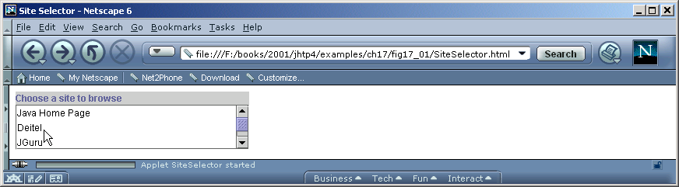

Program Output

Slide 11
17.3 Reading a File on a Web Server
Swing GUI component JEditorPane
  Can display simple text and HTML formatted text
  Can be used as a simple Web browser
    Retrieves files from a Web server at a given URI

Slide 12
ReadServerFile.java
Line 16
Line 17
1 // Fig. 17.3: ReadServerFile.java
2 // This program uses a JEditorPane to display the
3 // contents of a file on a Web server.
4
5 // Java core packages
6 import java.awt.*;
7 import java.awt.event.*;
8 import java.net.*;
9 import java.io.*;
10
11 // Java extension packages
12 import javax.swing.*;
13 import javax.swing.event.*;
14
15 public class ReadServerFile extends JFrame {
16 private JTextField enterField;
17 private JEditorPane contentsArea;
18
19 // set up GUI
20 public ReadServerFile()
21 {
22 super( "Simple Web Browser" );
23
24 Container container = getContentPane();
25
26 // create enterField and register its listener
27 enterField = new JTextField( "Enter file URL here" );
28
Write URI in JTextField
File displayed in JEditorPane

Slide 13
ReadServerFile.java
Lines 34-37
Line 36
Lines 49-63
Lines 54-59
Lines 56-57
Line 58
Method actionPerformed called when Enter key pressed in JTextField
29 enterField.addActionListener(
30
31 new ActionListener() {
32
33 // get document specified by user
34 public void actionPerformed( ActionEvent event )
35 {
36 getThePage( event.getActionCommand() );
37 }
38
39 } // end anonymous inner class
40
41 ); // end call to addActionListener
42
43 container.add( enterField, BorderLayout.NORTH );
44
45 // create contentsArea and register HyperlinkEvent listener
46 contentsArea = new JEditorPane();
47 contentsArea.setEditable( false );
48
49 contentsArea.addHyperlinkListener(
50
51 new HyperlinkListener() {
52
53 // if user clicked hyperlink, go to specified page
54 public void hyperlinkUpdate( HyperlinkEvent event )
55 {
56 if ( event.getEventType() ==
57 HyperlinkEvent.EventType.ACTIVATED )
58 getThePage( event.getURL().toString() );
59 }
60
61 } // end anonymous inner class
62
63 ); // end call to addHyperlinkListener
Get String from JTextField and call method getThePage
Register a HyperlinkListener to handle HyperlinkEvents
Method hyperlinkUpdate called when hyperlink clicked
Determine type of hyperlink
Get URL of hyperlink and retrieve page

Slide 14
ReadServerFile.java
Lines 73-95
Lines 76-77
Line 82
Line 83
Lines 87-91
Lines 93-94
64
65 container.add( new JScrollPane( contentsArea ),
66 BorderLayout.CENTER );
67
68 setSize( 400, 300 );
69 setVisible( true );
70 }
71
72 // load document; change mouse cursor to indicate status
73 private void getThePage( String location )
74 {
75 // change mouse cursor to WAIT_CURSOR
76 setCursor( Cursor.getPredefinedCursor(
77 Cursor.WAIT_CURSOR ) );
78
79 // load document into contentsArea and display location in
80 // enterField
81 try {
82 contentsArea.setPage( location );
83 enterField.setText( location );
84 }
85
86 // process problems loading document
87 catch ( IOException ioException ) {
88 JOptionPane.showMessageDialog( this,
89 "Error retrieving specified URL",
90 "Bad URL", JOptionPane.ERROR_MESSAGE );
91 }
92
93 setCursor( Cursor.getPredefinedCursor(
94 Cursor.DEFAULT_CURSOR ) );
95 }
96
Method getThePage loads requested document
Set mouse cursor to WAIT_CURSOR
Method setPage downloads document and displays it in JEditorPane
Display current location in enterField
Catch IOException if document fails to load
Set cursor to DEFAULT_CURSOR

Slide 15
ReadServerFile.java
97 // begin application execution
98 public static void main( String args[] )
99 {
100 ReadServerFile application = new ReadServerFile();
101
102 application.setDefaultCloseOperation(
103 JFrame.EXIT_ON_CLOSE );
104 }
105
106 } // end class ReadServerFile

Slide 16
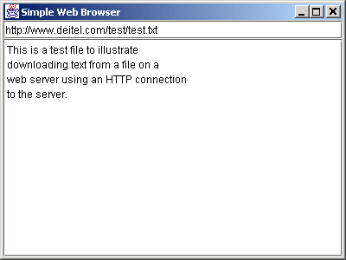
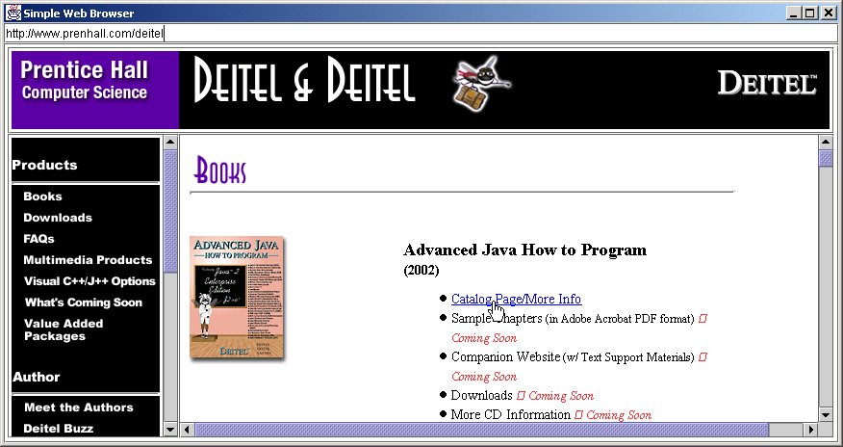
Program Output

Slide 17
17.4 Establishing a Simple Server Using Stream Sockets
Five steps to create a simple server in Java
  ServerSocket object
    Registers an available port and a maximum number of clients
  Each client connection handled with Server object
    Server blocks until client connects
  Sending and receiving data
    OutputStream to send and InputStream to receive data
    Methods getInputStream and getOutputstream
      Use on Socket object
  Process phase
    Server and Client communicate via streams
  Close streams and connections

Slide 18
17.5 Establishing a Simple Client Using Stream Sockets
Four steps to create a simple client in Java
  Create a Socket object for the client
  Obtain Socket’s InputStream and Outputstream
  Process information communicated
  Close streams and Socket

Slide 19
17.6 Client/Server Interaction with Stream Socket Connections
Client/server chat application
  Uses stream sockets as described in last two sections

Slide 20
Server.java
Lines 25-58
1 // Fig. 17.4: Server.java
2 // Set up a Server that will receive a connection
3 // from a client, send a string to the client,
4 // and close the connection.
5
6 // Java core packages
7 import java.io.*;
8 import java.net.*;
9 import java.awt.*;
10 import java.awt.event.*;
11
12 // Java extension packages
13 import javax.swing.*;
14
15 public class Server extends JFrame {
16 private JTextField enterField;
17 private JTextArea displayArea;
18 private ObjectOutputStream output;
19 private ObjectInputStream input;
20 private ServerSocket server;
21 private Socket connection;
22 private int counter = 1;
23
24 // set up GUI
25 public Server()
26 {
27 super( "Server" );
28
29 Container container = getContentPane();
30
31 // create enterField and register listener
32 enterField = new JTextField();
33 enterField.setEnabled( false );
34
Server’s constructor creates GUI

Slide 21
Server.java
Lines 40-43
35 enterField.addActionListener(
36
37 new ActionListener() {
38
39 // send message to client
40 public void actionPerformed( ActionEvent event )
41 {
42 sendData( event.getActionCommand() );
43 }
44
45 } // end anonymous inner class
46
47 ); // end call to addActionListener
48
49 container.add( enterField, BorderLayout.NORTH );
50
51 // create displayArea
52 displayArea = new JTextArea();
53 container.add( new JScrollPane( displayArea ),
54 BorderLayout.CENTER );
55
56 setSize( 300, 150 );
57 setVisible( true );
58 }
59
Call method actionPerformed when Enter key pressed

Slide 22
Server.java
Lines 61-97
Line 68
Line 73
Line 76
Line 79
Line 82
60 // set up and run server
61 public void runServer()
62 {
63 // set up server to receive connections;
64 // process connections
65 try {
66
67 // Step 1: Create a ServerSocket.
68 server = new ServerSocket( 5000, 100 );
69
70 while ( true ) {
71
72 // Step 2: Wait for a connection.
73 waitForConnection();
74
75 // Step 3: Get input and output streams.
76 getStreams();
77
78 // Step 4: Process connection.
79 processConnection();
80
81 // Step 5: Close connection.
82 closeConnection();
83
84 ++counter;
85 }
86 }
87
88 // process EOFException when client closes connection
89 catch ( EOFException eofException ) {
90 System.out.println( "Client terminated connection" );
91 }
92
Method runServer sets up server and processes connection
Create ServerSocket at port 5000 with queue of length 100
Call method waitForConnection to wait for client connection
Call method getStreams to get InputStream and OutputStream
Call method processConnection to process all messages
Call method closeConnection to terminate connection

Slide 23
Server.java
Lines 100-110
Line 105
Lines 107-109
Lines 113-127
Line 120
93 // process problems with I/O
94 catch ( IOException ioException ) {
95 ioException.printStackTrace();
96 }
97 }
98
99 // wait for connection to arrive, then display connection info
100 private void waitForConnection() throws IOException
101 {
102 displayArea.setText( "Waiting for connection\n" );
103
104 // allow server to accept a connection
105 connection = server.accept();
106
107 displayArea.append( "Connection " + counter +
108 " received from: " +
109 connection.getInetAddress().getHostName() );
110 }
111
112 // get streams to send and receive data
113 private void getStreams() throws IOException
114 {
115 // set up output stream for objects
116 output = new ObjectOutputStream(
117 connection.getOutputStream() );
118
119 // flush output buffer to send header information
120 output.flush();
121
122 // set up input stream for objects
123 input = new ObjectInputStream(
124 connection.getInputStream() );
125
126 displayArea.append( "\nGot I/O streams\n" );
127 }
Method waitForConnection waits for client connection
Method accept waits for connection
Output name of computer that connected
Method getStreams gets references to InputStream and OutputStream of Socket
Method flush empties output buffer and sends header information

Slide 24
Server.java
Lines 130-157
Lines 134-135
Lines 141-156
Lines 145-146
Lines 147-148
Method processConnection processes connections with clients
128
129 // process connection with client
130 private void processConnection() throws IOException
131 {
132 // send connection successful message to client
133 String message = "SERVER>>> Connection successful";
134 output.writeObject( message );
135 output.flush();
136
137 // enable enterField so server user can send messages
138 enterField.setEnabled( true );
139
140 // process messages sent from client
141 do {
142
143 // read message and display it
144 try {
145 message = ( String ) input.readObject();
146 displayArea.append( "\n" + message );
147 displayArea.setCaretPosition(
148 displayArea.getText().length() );
149 }
150
151 // catch problems reading from client
152 catch ( ClassNotFoundException classNotFoundException ) {
153 displayArea.append( "\nUnknown object type received" );
154 }
155
156 } while ( !message.equals( "CLIENT>>> TERMINATE" ) );
157 }
158
Send connection successful message to client
Loop until server receives terminate message
Read String from client and display it
Change cursor position

Slide 25
Server.java
Lines 160-167
Lines 170-183
159 // close streams and socket
160 private void closeConnection() throws IOException
161 {
162 displayArea.append( "\nUser terminated connection" );
163 enterField.setEnabled( false );
164 output.close();
165 input.close();
166 connection.close();
167 }
168
169 // send message to client
170 private void sendData( String message )
171 {
172 // send object to client
173 try {
174 output.writeObject( "SERVER>>> " + message );
175 output.flush();
176 displayArea.append( "\nSERVER>>>" + message );
177 }
178
179 // process problems sending object
180 catch ( IOException ioException ) {
181 displayArea.append( "\nError writing object" );
182 }
183 }
184
Method closeConnection closes streams and sockets
Method sendData sends a message to the client

Slide 26
Server.java
Lines 186-194
185 // execute application
186 public static void main( String args[] )
187 {
188 Server application = new Server();
189
190 application.setDefaultCloseOperation(
191 JFrame.EXIT_ON_CLOSE );
192
193 application.runServer();
194 }
195
196 } // end class Server
Method main creates an instance of Server and calls method runServer to run it

Slide 27
Client.java
Lines 24-60
1 // Fig. 17.5: Client.java
2 // Set up a Client that will read information sent
3 // from a Server and display the information.
4
5 // Java core packages
6 import java.io.*;
7 import java.net.*;
8 import java.awt.*;
9 import java.awt.event.*;
10
11 // Java extension packages
12 import javax.swing.*;
13
14 public class Client extends JFrame {
15 private JTextField enterField;
16 private JTextArea displayArea;
17 private ObjectOutputStream output;
18 private ObjectInputStream input;
19 private String message = "";
20 private String chatServer;
21 private Socket client;
22
23 // initialize chatServer and set up GUI
24 public Client( String host )
25 {
26 super( "Client" );
27
28 // set server to which this client connects
29 chatServer = host;
30
31 Container container = getContentPane();
32
33 // create enterField and register listener
34 enterField = new JTextField();
35 enterField.setEnabled( false );
Client’s constructor creates GUI

Slide 28
Client.java
Lines 42-45
37 enterField.addActionListener(
38
39 new ActionListener() {
40
41 // send message to server
42 public void actionPerformed( ActionEvent event )
43 {
44 sendData( event.getActionCommand() );
45 }
46
47 } // end anonymous inner class
48
49 ); // end call to addActionListener
50
51 container.add( enterField, BorderLayout.NORTH );
52
53 // create displayArea
54 displayArea = new JTextArea();
55 container.add( new JScrollPane( displayArea ),
56 BorderLayout.CENTER );
57
58 setSize( 300, 150 );
59 setVisible( true );
60 }
61
Method actionPerformed reads String from JTextField

Slide 29
Client.java
Lines 63-90
Line 69
Line 72
Line 75
Line 78
62 // connect to server and process messages from server
63 public void runClient()
64 {
65 // connect to server, get streams, process connection
66 try {
67
68 // Step 1: Create a Socket to make connection
69 connectToServer();
70
71 // Step 2: Get the input and output streams
72 getStreams();
73
74 // Step 3: Process connection
75 processConnection();
76
77 // Step 4: Close connection
78 closeConnection();
79 }
80
81 // server closed connection
82 catch ( EOFException eofException ) {
83 System.out.println( "Server terminated connection" );
84 }
85
86 // process problems communicating with server
87 catch ( IOException ioException ) {
88 ioException.printStackTrace();
89 }
90 }
91
Method runClient connects to server and processes messages
Call method connectToServer to make connection
Call method getStreams to get input and output streams
Call method processConnection to handle messages from server
Call method closeConnection to close connection

Slide 30
Client.java
Lines 93-106
Lines 110-121
92 // get streams to send and receive data
93 private void getStreams() throws IOException
94 {
95 // set up output stream for objects
96 output = new ObjectOutputStream(
97 client.getOutputStream() );
98
99 // flush output buffer to send header information
100 output.flush();
101
102 // set up input stream for objects
103 input = new ObjectInputStream(
104 client.getInputStream() );
105
106 displayArea.append( "\nGot I/O streams\n" );
107 }
108
109 // connect to server
110 private void connectToServer() throws IOException
111 {
112 displayArea.setText( "Attempting connection\n" );
113
114 // create Socket to make connection to server
115 client = new Socket(
116 InetAddress.getByName( chatServer ), 5000 );
117
118 // display connection information
119 displayArea.append( "Connected to: " +
120 client.getInetAddress().getHostName() );
121 }
122
Method getStreams gets streams to send and receive data
Method connectToServer connects to server

Slide 31
Client.java
Lines 124-147
Line 135
Lines 150-156
123 // process connection with server
124 private void processConnection() throws IOException
125 {
126 // enable enterField so client user can send messages
127 enterField.setEnabled( true );
128
129 // process messages sent from server
130 do {
131
132 // read message and display it
133 try {
134 message = ( String ) input.readObject();
135 displayArea.append( "\n" + message );
136 displayArea.setCaretPosition(
137 displayArea.getText().length() );
138 }
139
140 // catch problems reading from server
141 catch ( ClassNotFoundException classNotFoundException ) {
142 displayArea.append( "\nUnknown object type received" );
143 }
144
145 } while ( !message.equals( "SERVER>>> TERMINATE" ) );
146
147 } // end method process connection
148
149 // close streams and socket
150 private void closeConnection() throws IOException
151 {
152 displayArea.append( "\nClosing connection" );
153 output.close();
154 input.close();
155 client.close();
156 }
157
Method processConnection processes connection with server
Display message in JTextArea
Method closeConnection closes connection

Slide 32
Client.java
Lines 159-172
Lines 175-188
158 // send message to server
159 private void sendData( String message )
160 {
161 // send object to server
162 try {
163 output.writeObject( "CLIENT>>> " + message );
164 output.flush();
165 displayArea.append( "\nCLIENT>>>" + message );
166 }
167
168 // process problems sending object
169 catch ( IOException ioException ) {
170 displayArea.append( "\nError writing object" );
171 }
172 }
173
174 // execute application
175 public static void main( String args[] )
176 {
177 Client application;
178
179 if ( args.length == 0 )
180 application = new Client( "127.0.0.1" );
181 else
182 application = new Client( args[ 0 ] );
183
184 application.setDefaultCloseOperation(
185 JFrame.EXIT_ON_CLOSE );
186
187 application.runClient();
188 }
189
190 } // end class Client
Method sendData sends data to server
Method main creates a new Client and calls method runClient

Slide 33
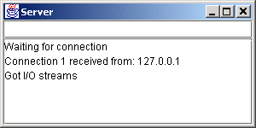
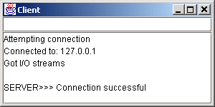
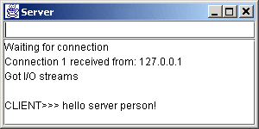
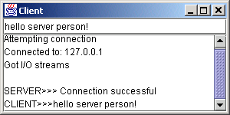
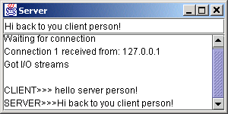
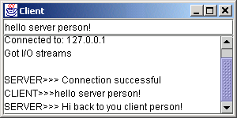
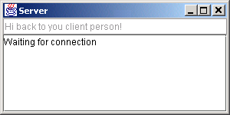
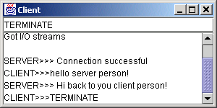
Program Output

Slide 34
17.7 Connectionless Client/Server Interaction with Datagrams
Connectionless transmission with datagrams
  No connection maintained with other computer
  Break message into equal sized pieces and send as packets
  Message arrive in order, out of order or not at all
  Receiver puts messages in order and reads them

Slide 35
Server.java
Lines 20-41
Line 32
1 // Fig. 17.6: Server.java
2 // Set up a Server that will receive packets from a
3 // client and send packets to a client.
4
5 // Java core packages
6 import java.io.*;
7 import java.net.*;
8 import java.awt.*;
9 import java.awt.event.*;
10
11 // Java extension packages
12 import javax.swing.*;
13
14 public class Server extends JFrame {
15 private JTextArea displayArea;
16 private DatagramPacket sendPacket, receivePacket;
17 private DatagramSocket socket;
18
19 // set up GUI and DatagramSocket
20 public Server()
21 {
22 super( "Server" );
23
24 displayArea = new JTextArea();
25 getContentPane().add( new JScrollPane( displayArea ),
26 BorderLayout.CENTER );
27 setSize( 400, 300 );
28 setVisible( true );
29
30 // create DatagramSocket for sending and receiving packets
31 try {
32 socket = new DatagramSocket( 5000 );
33 }
34
Constructor creates GUI
Create DatagramSocket at port 5000

Slide 36
Server.java
Lines 45-76
Lines 54-56
Line 59
35 // process problems creating DatagramSocket
36 catch( SocketException socketException ) {
37 socketException.printStackTrace();
38 System.exit( 1 );
39 }
40
41 } // end Server constructor
42
43 // wait for packets to arrive, then display data and echo
44 // packet to client
45 public void waitForPackets()
46 {
47 // loop forever
48 while ( true ) {
49
50 // receive packet, display contents, echo to client
51 try {
52
53 // set up packet
54 byte data[] = new byte[ 100 ];
55 receivePacket =
56 new DatagramPacket( data, data.length );
57
58 // wait for packet
59 socket.receive( receivePacket );
60
61 // process packet
62 displayPacket();
63
64 // echo information from packet back to client
65 sendPacketToClient();
66 }
67
Method waitForPackets uses an infinite loop to wait for packets to arrive
Create a DatagramPacket to store received information
Method receive blocks until a packet is received

Slide 37
Server.java
Lines 79-88
Line 82
Line 83
Line 84
Line 86
Lines 91-106
Lines 96-98
Line 101
68 // process problems manipulating packet
69 catch( IOException ioException ) {
70 displayArea.append( ioException.toString() + "\n" );
71 ioException.printStackTrace();
72 }
73
74 } // end while
75
76 } // end method waitForPackets
77
78 // display packet contents
79 private void displayPacket()
80 {
81 displayArea.append( "\nPacket received:" +
82 "\nFrom host: " + receivePacket.getAddress() +
83 "\nHost port: " + receivePacket.getPort() +
84 "\nLength: " + receivePacket.getLength() +
85 "\nContaining:\n\t" +
86 new String( receivePacket.getData(), 0,
87 receivePacket.getLength() ) );
88 }
89
90 // echo packet to client
91 private void sendPacketToClient() throws IOException
92 {
93 displayArea.append( "\n\nEcho data to client..." );
94
95 // create packet to send
96 sendPacket = new DatagramPacket( receivePacket.getData(),
97 receivePacket.getLength(), receivePacket.getAddress(),
98 receivePacket.getPort() );
99
100 // send packet
101 socket.send( sendPacket );
Method displayPacket appends packet’s contents to displayArea
Method getAddress returns name of computer that sent packet
Method sendPacketToClient echoes the packet to the client
Method getPort returns the port the packet came through
Create packet to be sent
Method getLength returns the length of the message sent
Method getData returns a byte array containing the sent data
Method send sends the pack over the network

Slide 38
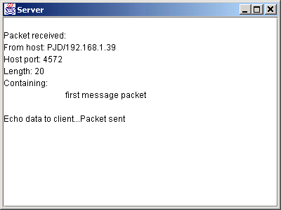
Server.java
Lines 109-117
Program Output
102
103 displayArea.append( "Packet sent\n" );
104 displayArea.setCaretPosition(
105 displayArea.getText().length() );
106 }
107
108 // execute application
109 public static void main( String args[] )
110 {
111 Server application = new Server();
112
113 application.setDefaultCloseOperation(
114 JFrame.EXIT_ON_CLOSE );
115
116 application.waitForPackets();
117 }
118
119 } // end class Server
Method main creates a new server and waits for packets

Slide 39
Client.java
Lines 21-93
1 // Fig. 17.7: Client.java
2 // Set up a Client that will send packets to a
3 // server and receive packets from a server.
4
5 // Java core packages
6 import java.io.*;
7 import java.net.*;
8 import java.awt.*;
9 import java.awt.event.*;
10
11 // Java extension packages
12 import javax.swing.*;
13
14 public class Client extends JFrame {
15 private JTextField enterField;
16 private JTextArea displayArea;
17 private DatagramPacket sendPacket, receivePacket;
18 private DatagramSocket socket;
19
20 // set up GUI and DatagramSocket
21 public Client()
22 {
23 super( "Client" );
24
25 Container container = getContentPane();
26
27 enterField = new JTextField( "Type message here" );
28
Constructor sets up GUI and DatagramSocket object

Slide 40
Client.java
Lines 34-67
Line 45
Lines 48-50
Line 53
29 enterField.addActionListener(
30
31 new ActionListener() {
32
33 // create and send a packet
34 public void actionPerformed( ActionEvent event )
35 {
36 // create and send packet
37 try {
38 displayArea.append(
39 "\nSending packet containing: " +
40 event.getActionCommand() + "\n" );
41
42 // get message from textfield and convert to
43 // array of bytes
44 String message = event.getActionCommand();
45 byte data[] = message.getBytes();
46
47 // create sendPacket
48 sendPacket = new DatagramPacket(
49 data, data.length,
50 InetAddress.getLocalHost(), 5000 );
51
52 // send packet
53 socket.send( sendPacket );
54
55 displayArea.append( "Packet sent\n" );
56 displayArea.setCaretPosition(
57 displayArea.getText().length() );
58 }
59
Method actionPerformed converts a String to a byte array to be sent as a datagram
Convert the String to a byte array
Create the DatagramPacket to send
Send the packet with method send

Slide 41
Client.java
Line 84
60 // process problems creating or sending packet
61 catch ( IOException ioException ) {
62 displayArea.append(
63 ioException.toString() + "\n" );
64 ioException.printStackTrace();
65 }
66
67 } // end actionPerformed
68
69 } // end anonymous inner class
70
71 ); // end call to addActionListener
72
73 container.add( enterField, BorderLayout.NORTH );
74
75 displayArea = new JTextArea();
76 container.add( new JScrollPane( displayArea ),
77 BorderLayout.CENTER );
78
79 setSize( 400, 300 );
80 setVisible( true );
81
82 // create DatagramSocket for sending and receiving packets
83 try {
84 socket = new DatagramSocket();
85 }
86
87 // catch problems creating DatagramSocket
88 catch( SocketException socketException ) {
89 socketException.printStackTrace();
90 System.exit( 1 );
91 }
92
93 } // end Client constructor
94
Create DatagramSocket for sending and receiving packets

Slide 42
Client.java
Lines 97-125
Line 111
Line 114
95 // wait for packets to arrive from Server,
96 // then display packet contents
97 public void waitForPackets()
98 {
99 // loop forever
100 while ( true ) {
101
102 // receive packet and display contents
103 try {
104
105 // set up packet
106 byte data[] = new byte[ 100 ];
107 receivePacket =
108 new DatagramPacket( data, data.length );
109
110 // wait for packet
111 socket.receive( receivePacket );
112
113 // display packet contents
114 displayPacket();
115 }
116
117 // process problems receiving or displaying packet
118 catch( IOException exception ) {
119 displayArea.append( exception.toString() + "\n" );
120 exception.printStackTrace();
121 }
122
123 } // end while
124
125 } // end method waitForPackets
126
Method waitForPackets uses an infinite loop to wait for packets from server
Block until packet arrives
Display contents of packet

Slide 43
Client.java
Lines 128-140
127 // display contents of receivePacket
128 private void displayPacket()
129 {
130 displayArea.append( "\nPacket received:" +
131 "\nFrom host: " + receivePacket.getAddress() +
132 "\nHost port: " + receivePacket.getPort() +
133 "\nLength: " + receivePacket.getLength() +
134 "\nContaining:\n\t" +
135 new String( receivePacket.getData(), 0,
136 receivePacket.getLength() ) );
137
138 displayArea.setCaretPosition(
139 displayArea.getText().length() );
140 }
141
142 // execute application
143 public static void main( String args[] )
144 {
145 Client application = new Client();
146
147 application.setDefaultCloseOperation(
148 JFrame.EXIT_ON_CLOSE );
149
150 application.waitForPackets();
151 }
152
153 } // end class Client
Method displayPacket displays packet contents in JTextArea

Slide 44
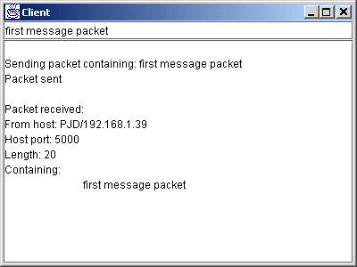
Program Output

Slide 45
17.8 Client/Server Tic-Tac-Toe Using a Multithreaded Server
Multiple threads
  Server uses one thread per player
    Allow each player to play game independently

Slide 46
TicTacToeServer.java
Lines 22-48
1 // Fig. 17.8: TicTacToeServer.java
2 // This class maintains a game of Tic-Tac-Toe for two
3 // client applets.
4
5 // Java core packages
6 import java.awt.*;
7 import java.awt.event.*;
8 import java.net.*;
9 import java.io.*;
10
11 // Java extension packages
12 import javax.swing.*;
13
14 public class TicTacToeServer extends JFrame {
15 private byte board[];
16 private JTextArea outputArea;
17 private Player players[];
18 private ServerSocket server;
19 private int currentPlayer;
20
21 // set up tic-tac-toe server and GUI that displays messages
22 public TicTacToeServer()
23 {
24 super( "Tic-Tac-Toe Server" );
25
26 board = new byte[ 9 ];
27 players = new Player[ 2 ];
28 currentPlayer = 0;
29
30 // set up ServerSocket
31 try {
32 server = new ServerSocket( 5000, 2 );
33 }
34
Constructor creates a ServerSocket and server GUI

Slide 47
TicTacToeServer.java
Lines 51-76
Line 58
Line 59
35 // process problems creating ServerSocket
36 catch( IOException ioException ) {
37 ioException.printStackTrace();
38 System.exit( 1 );
39 }
40
41 // set up JTextArea to display messages during execution
42 outputArea = new JTextArea();
43 getContentPane().add( outputArea, BorderLayout.CENTER );
44 outputArea.setText( "Server awaiting connections\n" );
45
46 setSize( 300, 300 );
47 setVisible( true );
48 }
49
50 // wait for two connections so game can be played
51 public void execute()
52 {
53 // wait for each client to connect
54 for ( int i = 0; i < players.length; i++ ) {
55
56 // wait for connection, create Player, start thread
57 try {
58 players[ i ] = new Player( server.accept(), i );
59 players[ i ].start();
60 }
61
62 // process problems receiving connection from client
63 catch( IOException ioException ) {
64 ioException.printStackTrace();
65 System.exit( 1 );
66 }
67 }
68
Method execute waits for two connections to start game
Block while waiting for each player
Call start method to begin executing thread

Slide 48
TicTacToeServer.java
Lines 87-129
69 // Player X is suspended until Player O connects.
70 // Resume player X now.
71 synchronized ( players[ 0 ] ) {
72 players[ 0 ].setSuspended( false );
73 players[ 0 ].notify();
74 }
75
76 } // end method execute
77
78 // display a message in outputArea
79 public void display( String message )
80 {
81 outputArea.append( message + "\n" );
82 }
83
84 // Determine if a move is valid.
85 // This method is synchronized because only one move can be
86 // made at a time.
87 public synchronized boolean validMove(
88 int location, int player )
89 {
90 boolean moveDone = false;
91
92 // while not current player, must wait for turn
93 while ( player != currentPlayer ) {
94
95 // wait for turn
96 try {
97 wait();
98 }
99
100 // catch wait interruptions
101 catch( InterruptedException interruptedException ) {
102 interruptedException.printStackTrace();
103 }
Method validMove allows only one move at a time

Slide 49
TicTacToeServer.java
Lines 110-111
Line 117
Line 120
Line 123
104 }
105
106 // if location not occupied, make move
107 if ( !isOccupied( location ) ) {
108
109 // set move in board array
110 board[ location ] =
111 ( byte ) ( currentPlayer == 0 ? 'X' : 'O' );
112
113 // change current player
114 currentPlayer = ( currentPlayer + 1 ) % 2;
115
116 // let new current player know that move occurred
117 players[ currentPlayer ].otherPlayerMoved( location );
118
119 // tell waiting player to continue
120 notify();
121
122 // tell player that made move that the move was valid
123 return true;
124 }
125
126 // tell player that made move that the move was not valid
127 else
128 return false;
129 }
130
131 // determine whether location is occupied
132 public boolean isOccupied( int location )
133 {
134 if ( board[ location ] == 'X' || board [ location ] == 'O' )
135 return true;
136 else
137 return false;
138 }
Place a mark on the board
Notify player a move occurred
Invoke method notify to tell waiting player to continue
Confirm valid move to player

Slide 50
TicTacToeServer.java
Lines 147-155
Lines 167-189
139
140 // place code in this method to determine whether game over
141 public boolean gameOver()
142 {
143 return false;
144 }
145
146 // execute application
147 public static void main( String args[] )
148 {
149 TicTacToeServer application = new TicTacToeServer();
150
151 application.setDefaultCloseOperation(
152 JFrame.EXIT_ON_CLOSE );
153
154 application.execute();
155 }
156
157 // private inner class Player manages each Player as a thread
158 private class Player extends Thread {
159 private Socket connection;
160 private DataInputStream input;
161 private DataOutputStream output;
162 private int playerNumber;
163 private char mark;
164 protected boolean suspended = true;
165
166 // set up Player thread
167 public Player( Socket socket, int number )
168 {
169 playerNumber = number;
170
171 // specify player's mark
172 mark = ( playerNumber == 0 ? 'X' : 'O' );
173
Method main creates an instance of TicTacToeServer and calls method execute
The Player constructor receives a Socket object and gets its input and output streams

Slide 51
TicTacToeServer.java
174 connection = socket;
175
176 // obtain streams from Socket
177 try {
178 input = new DataInputStream(
179 connection.getInputStream() );
180 output = new DataOutputStream(
181 connection.getOutputStream() );
182 }
183
184 // process problems getting streams
185 catch( IOException ioException ) {
186 ioException.printStackTrace();
187 System.exit( 1 );
188 }
189 }
190
191 // send message that other player moved; message contains
192 // a String followed by an int
193 public void otherPlayerMoved( int location )
194 {
195 // send message indicating move
196 try {
197 output.writeUTF( "Opponent moved" );
198 output.writeInt( location );
199 }
200
201 // process problems sending message
202 catch ( IOException ioException ) {
203 ioException.printStackTrace();
204 }
205 }
206

Slide 52
TicTacToeServer.java
Lines 208-271
Lines 213-214
Line 217
Lines 230-233
207 // control thread's execution
208 public void run()
209 {
210 // send client message indicating its mark (X or O),
211 // process messages from client
212 try {
213 display( "Player " + ( playerNumber == 0 ?
214 'X' : 'O' ) + " connected" );
215
216 // send player's mark
217 output.writeChar( mark );
218
219 // send message indicating connection
220 output.writeUTF( "Player " +
221 ( playerNumber == 0 ? "X connected\n" :
222 "O connected, please wait\n" ) );
223
224 // if player X, wait for another player to arrive
225 if ( mark == 'X' ) {
226 output.writeUTF( "Waiting for another player" );
227
228 // wait for player O
229 try {
230 synchronized( this ) {
231 while ( suspended )
232 wait();
233 }
234 }
235
236 // process interruptions while waiting
237 catch ( InterruptedException exception ) {
238 exception.printStackTrace();
239 }
240
Method run controls information sent and received by client
Tell client that client’s connection is made
Send player’s mark
Suspend each thread as it starts executing

Slide 53
TicTacToeServer.java
Lines 248-260
Line 251
Line 254
Lines 254-259
241 // send message that other player connected and
242 // player X can make a move
243 output.writeUTF(
244 "Other player connected. Your move." );
245 }
246
247 // while game not over
248 while ( ! gameOver() ) {
249
250 // get move location from client
251 int location = input.readInt();
252
253 // check for valid move
254 if ( validMove( location, playerNumber ) ) {
255 display( "loc: " + location );
256 output.writeUTF( "Valid move." );
257 }
258 else
259 output.writeUTF( "Invalid move, try again" );
260 }
261
262 // close connection to client
263 connection.close();
264 }
265
266 // process problems communicating with client
267 catch( IOException ioException ) {
268 ioException.printStackTrace();
269 System.exit( 1 );
270 }
271 }
272
Loop until game is over
Read move location
Check if valid move
Send message to client

Slide 54
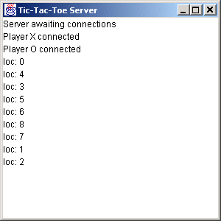
TicTacToeServer.java
Program Output
273 // set whether or not thread is suspended
274 public void setSuspended( boolean status )
275 {
276 suspended = status;
277 }
278
279 } // end class Player
280
281 } // end class TicTacToeServer

Slide 55
TicTacToeClient.java
Lines 30-75
1 // Fig. 17.9: TicTacToeClient.java
2 // Client for the TicTacToe program
3
4 // Java core packages
5 import java.awt.*;
6 import java.awt.event.*;
7 import java.net.*;
8 import java.io.*;
9
10 // Java extension packages
11 import javax.swing.*;
12
13 // Client class to let a user play Tic-Tac-Toe with
14 // another user across a network.
15 public class TicTacToeClient extends JApplet
16 implements Runnable {
17
18 private JTextField idField;
19 private JTextArea displayArea;
20 private JPanel boardPanel, panel2;
21 private Square board[][], currentSquare;
22 private Socket connection;
23 private DataInputStream input;
24 private DataOutputStream output;
25 private Thread outputThread;
26 private char myMark;
27 private boolean myTurn;
28
29 // Set up user-interface and board
30 public void init()
31 {
32 Container container = getContentPane();
33
Method init sets up GUI

Slide 56
TicTacToeClient.java
34 // set up JTextArea to display messages to user
35 displayArea = new JTextArea( 4, 30 );
36 displayArea.setEditable( false );
37 container.add( new JScrollPane( displayArea ),
38 BorderLayout.SOUTH );
39
40 // set up panel for squares in board
41 boardPanel = new JPanel();
42 boardPanel.setLayout( new GridLayout( 3, 3, 0, 0 ) );
43
44 // create board
45 board = new Square[ 3 ][ 3 ];
46
47 // When creating a Square, the location argument to the
48 // constructor is a value from 0 to 8 indicating the
49 // position of the Square on the board. Values 0, 1,
50 // and 2 are the first row, values 3, 4, and 5 are the
51 // second row. Values 6, 7, and 8 are the third row.
52 for ( int row = 0; row < board.length; row++ ) {
53
54 for ( int column = 0;
55 column < board[ row ].length; column++ ) {
56
57 // create Square
58 board[ row ][ column ] =
59 new Square( ' ', row * 3 + column );
60
61 boardPanel.add( board[ row ][ column ] );
62 }
63
64 }
65
66 // textfield to display player's mark
67 idField = new JTextField();
68 idField.setEditable( false );

Slide 57
TicTacToeClient.java
Lines 80-104
69 container.add( idField, BorderLayout.NORTH );
70
71 // set up panel to contain boardPanel (for layout purposes)
72 panel2 = new JPanel();
73 panel2.add( boardPanel, BorderLayout.CENTER );
74 container.add( panel2, BorderLayout.CENTER );
75 }
76
77 // Make connection to server and get associated streams.
78 // Start separate thread to allow this applet to
79 // continually update its output in text area display.
80 public void start()
81 {
82 // connect to server, get streams and start outputThread
83 try {
84
85 // make connection
86 connection = new Socket(
87 InetAddress.getByName( "127.0.0.1" ), 5000 );
88
89 // get streams
90 input = new DataInputStream(
91 connection.getInputStream() );
92 output = new DataOutputStream(
93 connection.getOutputStream() );
94 }
95
96 // catch problems setting up connection and streams
97 catch ( IOException ioException ) {
98 ioException.printStackTrace();
99 }
100
Method start opens a connection to server and gets input and output streams

Slide 58
TicTacToeClient.java
Lines 102-103
Lines 108-137
Line 112
Lines 123-135
Lines 127
101 // create and start output thread
102 outputThread = new Thread( this );
103 outputThread.start();
104 }
105
106 // control thread that allows continuous update of the
107 // text area displayArea
108 public void run()
109 {
110 // get player's mark (X or O)
111 try {
112 myMark = input.readChar();
113 idField.setText( "You are player \"" + myMark + "\"" );
114 myTurn = ( myMark == 'X' ? true : false );
115 }
116
117 // process problems communicating with server
118 catch ( IOException ioException ) {
119 ioException.printStackTrace();
120 }
121
122 // receive messages sent to client and output them
123 while ( true ) {
124
125 // read message from server and process message
126 try {
127 String message = input.readUTF();
128 processMessage( message );
129 }
130
131 // process problems communicating with server
132 catch ( IOException ioException ) {
133 ioException.printStackTrace();
134 }
135 }
Create outputThread and call method start
Method run controls the separate thread of execution
Read mark character from server
Loop continually
Read and process messages from server

Slide 59
TicTacToeClient.java
Lines 140-211
Lines 143-159
Lines 162-165
Lines 168-195
136
137 } // end method run
138
139 // process messages received by client
140 public void processMessage( String message )
141 {
142 // valid move occurred
143 if ( message.equals( "Valid move." ) ) {
144 displayArea.append( "Valid move, please wait.\n" );
145
146 // set mark in square from event-dispatch thread
147 SwingUtilities.invokeLater(
148
149 new Runnable() {
150
151 public void run()
152 {
153 currentSquare.setMark( myMark );
154 }
155
156 }
157
158 ); // end call to invokeLater
159 }
160
161 // invalid move occurred
162 else if ( message.equals( "Invalid move, try again" ) ) {
163 displayArea.append( message + "\n" );
164 myTurn = true;
165 }
166
167 // opponent moved
168 else if ( message.equals( "Opponent moved" ) ) {
169
Method processMessage processes messages received by client
If valid move, write message and set mark in square
If invalid move, display message
If opponent moves, set mark in square

Slide 60
TicTacToeClient.java
170 // get move location and update board
171 try {
172 final int location = input.readInt();
173
174 // set mark in square from event-dispatch thread
175 SwingUtilities.invokeLater(
176
177 new Runnable() {
178
179 public void run()
180 {
181 int row = location / 3;
182 int column = location % 3;
183
184 board[ row ][ column ].setMark(
185 ( myMark == 'X' ? 'O' : 'X' ) );
186 displayArea.append(
187 "Opponent moved. Your turn.\n" );
188 }
189
190 }
191
192 ); // end call to invokeLater
193
194 myTurn = true;
195 }
196
197 // process problems communicating with server
198 catch ( IOException ioException ) {
199 ioException.printStackTrace();
200 }
201
202 }
203

Slide 61
TicTacToeClient.java
Line 206
204 // simply display message
205 else
206 displayArea.append( message + "\n" );
207
208 displayArea.setCaretPosition(
209 displayArea.getText().length() );
210
211 } // end method processMessage
212
213 // send message to server indicating clicked square
214 public void sendClickedSquare( int location )
215 {
216 if ( myTurn ) {
217
218 // send location to server
219 try {
220 output.writeInt( location );
221 myTurn = false;
222 }
223
224 // process problems communicating with server
225 catch ( IOException ioException ) {
226 ioException.printStackTrace();
227 }
228 }
229 }
230
231 // set current Square
232 public void setCurrentSquare( Square square )
233 {
234 currentSquare = square;
235 }
236
If any other message, display message

Slide 62
TicTacToeClient.java
237 // private class for the sqaures on the board
238 private class Square extends JPanel {
239 private char mark;
240 private int location;
241
242 public Square( char squareMark, int squareLocation )
243 {
244 mark = squareMark;
245 location = squareLocation;
246
247 addMouseListener(
248
249 new MouseAdapter() {
250
251 public void mouseReleased( MouseEvent e )
252 {
253 setCurrentSquare( Square.this );
254 sendClickedSquare( getSquareLocation() );
255 }
256
257 } // end anonymous inner class
258
259 ); // end call to addMouseListener
260
261 } // end Square constructor
262
263 // return preferred size of Square
264 public Dimension getPreferredSize()
265 {
266 return new Dimension( 30, 30 );
267 }
268

Slide 63
TicTacToeClient.java
269 // return minimum size of Square
270 public Dimension getMinimumSize()
271 {
272 return getPreferredSize();
273 }
274
275 // set mark for Square
276 public void setMark( char newMark )
277 {
278 mark = newMark;
279 repaint();
280 }
281
282 // return Square location
283 public int getSquareLocation()
284 {
285 return location;
286 }
287
288 // draw Square
289 public void paintComponent( Graphics g )
290 {
291 super.paintComponent( g );
292
293 g.drawRect( 0, 0, 29, 29 );
294 g.drawString( String.valueOf( mark ), 11, 20 );
295 }
296
297 } // end class Square
298
299 } // end class TicTacToeClient

Slide 64
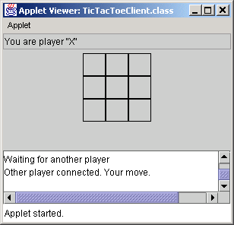
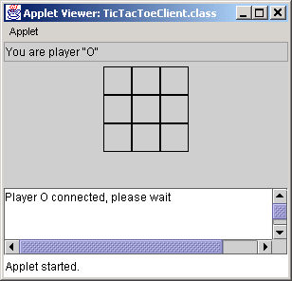
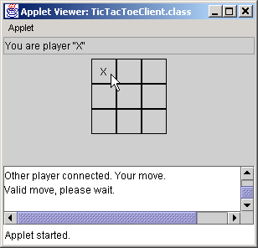

Program Output

Slide 65
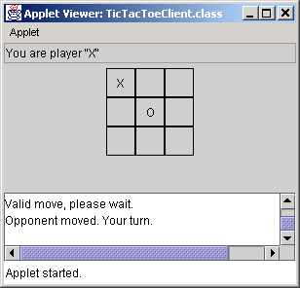
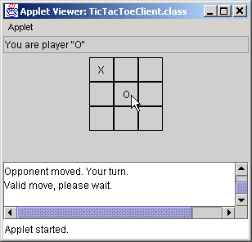


Program Output

Slide 66
17.9 Security and the Network
By default, applets cannot perform file processing
Applets often limited in machine access
Java Security API
  Applets given more privileges if from trusted source

Slide 67
17.10 DeitelMessenger Chat Server and Client
Chat rooms
  Each user can post a message and read all other messages
  Multicast
    Send packets to groups of clients

Slide 68
17.10.1 DeitelMessengerServer and Supporting Classes
DeitelMessengerServer
  Online chat system
  Classes:
    DeitelMessengerServer
      Clients connect to this server
    Interface SocketMessengerConstants
      Defines constants for port numbers
    Interface MessageListener
      Defines method for receiving new chat messages
    Class ReceivingThread
      Separate thread listens for messages from clients
    Class MulticastSendingThread
      Separate thread delivers outgoing messages to clients

Slide 69
DeitelMessengerServer.java
Lines 19-54
Lines 25-26
1 // DeitelMessengerServer.java
2 // DeitelMessengerServer is a multi-threaded, socket- and
3 // packet-based chat server.
4 package com.deitel.messenger.sockets.server;
5
6 // Java core packages
7 import java.util.*;
8 import java.net.*;
9 import java.io.*;
10
11 // Deitel packages
12 import com.deitel.messenger.*;
13 import com.deitel.messenger.sockets.*;
14
15 public class DeitelMessengerServer implements MessageListener,
16 SocketMessengerConstants {
17
18 // start chat server
19 public void startServer()
20 {
21 // create server and manage new clients
22 try {
23
24 // create ServerSocket for incoming connections
25 ServerSocket serverSocket =
26 new ServerSocket( SERVER_PORT, 100 );
27
28 System.out.println( "Server listening on port " +
29 SERVER_PORT + " ..." );
30
Method startServer launches the chat server
Create ServerSocket to accept incoming connections

Slide 70
DeitelMessengerServer.java
Lines 32-45
Line 35
Line 39
31 // listen for clients constantly
32 while ( true ) {
33
34 // accept new client connection
35 Socket clientSocket = serverSocket.accept();
36
37 // create new ReceivingThread for receiving
38 // messages from client
39 new ReceivingThread( this, clientSocket ).start();
40
41 // print connection information
42 System.out.println( "Connection received from: " +
43 clientSocket.getInetAddress() );
44
45 } // end while
46
47 } // end try
48
49 // handle exception creating server and connecting clients
50 catch ( IOException ioException ) {
51 ioException.printStackTrace();
52 }
53
54 } // end method startServer
55
Listen continuously for new clients
Invoke method accept to wait for and accept a new client connection
Create and start a new ReceivingThread

Slide 71
DeitelMessengerServer.java
Lines 57-66
Lines 64-65
Lines 69-72
Program Output
Method messageReceived broadcasts new messages to clients
56 // when new message is received, broadcast message to clients
57 public void messageReceived( String from, String message )
58 {
59 // create String containing entire message
60 String completeMessage = from + MESSAGE_SEPARATOR + message;
61
62 // create and start MulticastSendingThread to broadcast
63 // new messages to all clients
64 new MulticastSendingThread(
65 completeMessage.getBytes() ).start();
66 }
67
68 // start the server
69 public static void main ( String args[] )
70 {
71 new DeitelMessengerServer().startServer();
72 }
73 }
Concatenate from String and message
Create and start new MulticastSendingThread to send messages to all clients
Method main creates a new DeitelMessengerServer and starts the server
Server listening on port 5000 ...
Connection received from: SEANSANTRY/XXX.XXX.XXX.XXX
Connection received from: PJD/XXX.XXX.XXX.XXX

Slide 72
SocketMessengerConstants.java
Line 9
Line 12
Line 15
Line 18
Line 21
Line 24
Line 27
1 // SocketMessengerConstants.java
2 // SocketMessengerConstants defines constants for the port numbers
3 // and multicast address in DeitelMessenger
4 package com.deitel.messenger.sockets;
5
6 public interface SocketMessengerConstants {
7
8 // address for multicast datagrams
9 public static final String MULTICAST_ADDRESS = "230.0.0.1";
10
11 // port for listening for multicast datagrams
12 public static final int MULTICAST_LISTENING_PORT = 5555;
13
14 // port for sending multicast datagrams
15 public static final int MULTICAST_SENDING_PORT = 5554;
16
17 // port for Socket connections to DeitelMessengerServer
18 public static final int SERVER_PORT = 5000;
19
20 // String that indicates disconnect
21 public static final String DISCONNECT_STRING = "DISCONNECT";
22
23 // String that separates the user name from the message body
24 public static final String MESSAGE_SEPARATOR = ">>>";
25
26 // message size (in bytes)
27 public static final int MESSAGE_SIZE = 512;
28 }
Address to send multicast datagrams
Port listening for multicast datagrams
Port for sending multicast datagrams
Port for socket connections to server
String that indicates disconnect
String that separates user name and message
Maximum message size in bytes

Slide 73
MessengerListener.java
Line 9
1 // MessageListener.java
2 // MessageListener is an interface for classes that wish to
3 // receive new chat messages.
4 package com.deitel.messenger;
5
6 public interface MessageListener {
7
8 // receive new chat message
9 public void messageReceived( String from, String message );
10 }
Method messageReceived allows an implementing class to receive messages

Slide 74
ReceivingThread.java.
Line 28
Line 31
1 // ReceivingThread.java
2 // ReceivingThread is a Thread that listens for messages
3 // from a particular client and delivers messages to a
4 // MessageListener.
5 package com.deitel.messenger.sockets.server;
6
7 // Java core packages
8 import java.io.*;
9 import java.net.*;
10 import java.util.StringTokenizer;
11
12 // Deitel packages
13 import com.deitel.messenger.*;
14 import com.deitel.messenger.sockets.*;
15
16 public class ReceivingThread extends Thread implements
17 SocketMessengerConstants {
18
19 private BufferedReader input;
20 private MessageListener messageListener;
21 private boolean keepListening = true;
22
23 // ReceivingThread constructor
24 public ReceivingThread( MessageListener listener,
25 Socket clientSocket )
26 {
27 // invoke superclass constructor to name Thread
28 super( "ReceivingThread: " + clientSocket );
29
30 // set listener to which new messages should be sent
31 messageListener = listener;
32
Invoke Thread constructor to provide unique name for each ReceivingThread
Set MessageListener to which ReceivingThread should deliver new messages

Slide 75
ReceivingThread.java (Part 2).
Lines 38-39
Line 55
Line 59
33 // set timeout for reading from clientSocket and create
34 // BufferedReader for reading incoming messages
35 try {
36 clientSocket.setSoTimeout( 5000 );
37
38 input = new BufferedReader( new InputStreamReader(
39 clientSocket.getInputStream() ) );
40 }
41
42 // handle exception creating BufferedReader
43 catch ( IOException ioException ) {
44 ioException.printStackTrace();
45 }
46
47 } // end ReceivingThread constructor
48
49 // listen for new messages and deliver them to MessageListener
50 public void run()
51 {
52 String message;
53
54 // listen for messages until stopped
55 while ( keepListening ) {
56
57 // read message from BufferedReader
58 try {
59 message = input.readLine();
60 }
61
62 // handle exception if read times out
63 catch ( InterruptedIOException interruptedIOException ) {
64
65 // continue to next iteration to keep listening
66 continue;
67 }
Create BufferedReader to read messages from client
Listen for messages, as long as keepListening is true
Read line of data from client

Slide 76
ReceivingThread.java (Part 3).
Lines 80-90
68
69 // handle exception reading message
70 catch ( IOException ioException ) {
71 ioException.printStackTrace();
72 break;
73 }
74
75 // ensure non-null message
76 if ( message != null ) {
77
78 // tokenize message to retrieve user name
79 // and message body
80 StringTokenizer tokenizer =
81 new StringTokenizer( message, MESSAGE_SEPARATOR );
82
83 // ignore messages that do not contain a user
84 // name and message body
85 if ( tokenizer.countTokens() == 2 ) {
86
87 // send message to MessageListener
88 messageListener.messageReceived(
89 tokenizer.nextToken(), // user name
90 tokenizer.nextToken() ); // message body
91 }
92
Upon receiving message, separate message into two tokens delimited by Message_SEPARATOR

Slide 77
ReceivingThread.java (Part 4).
Lines 96-97
Lines 119-122
93 else
94
95 // if disconnect message received, stop listening
96 if ( message.equalsIgnoreCase( MESSAGE_SEPARATOR +
97 DISCONNECT_STRING ) ) {
98
99 stopListening();
100 }
101
102 } // end if
103
104 } // end while
105
106 // close BufferedReader (also closes Socket)
107 try {
108 input.close();
109 }
110
111 // handle exception closing BufferedReader
112 catch ( IOException ioException ) {
113 ioException.printStackTrace();
114 }
115
116 } // end method run
117
118 // stop listening for incoming messages
119 public void stopListening()
120 {
121 keepListening = false;
122 }
123 }
Determine whether message indicates that user wishes to leave chat room
Method stopListening terminates while loop in method run

Slide 78
MulticastSendingThread.java
Line 13
Line 17
1 // MulticastSendingThread.java
2 // MulticastSendingThread is a Thread that broadcasts a chat
3 // message using a multicast datagram.
4 package com.deitel.messenger.sockets.server;
5
6 // Java core packages
7 import java.io.*;
8 import java.net.*;
9
10 // Deitel packages
11 import com.deitel.messenger.sockets.*;
12
13 public class MulticastSendingThread extends Thread
14 implements SocketMessengerConstants {
15
16 // message data
17 private byte[] messageBytes;
18
19 // MulticastSendingThread constructor
20 public MulticastSendingThread( byte[] bytes )
21 {
22 // invoke superclass constructor to name Thread
23 super( "MulticastSendingThread" );
24
25 messageBytes = bytes;
26 }
27
Extend Thread to enable DeitelMessengerServer to send multicast messages in a separate thread
byte array to contain message data

Slide 79
MulticastSendingThread.java
(Part 2).
Lines 29-57
Lines 35-36
Lines 39-40
Lines 43-48
28 // deliver message to MULTICAST_ADDRESS over DatagramSocket
29 public void run()
30 {
31 // deliver message
32 try {
33
34 // create DatagramSocket for sending message
35 DatagramSocket socket =
36 new DatagramSocket( MULTICAST_SENDING_PORT );
37
38 // use InetAddress reserved for multicast group
39 InetAddress group = InetAddress.getByName(
40 MULTICAST_ADDRESS );
41
42 // create DatagramPacket containing message
43 DatagramPacket packet = new DatagramPacket(
44 messageBytes, messageBytes.length, group,
45 MULTICAST_LISTENING_PORT );
46
47 // send packet to multicast group and close socket
48 socket.send( packet );
49 socket.close();
50 }
51
52 // handle exception delivering message
53 catch ( IOException ioException ) {
54 ioException.printStackTrace();
55 }
56
57 } // end method run
58 }
Method run delivers message to multicast address
Create DatagramSocket for delivering DatagramPackets via multicast
Specify multicast address
Create DatagramPacket and send it to clients

Slide 80
17.10.2 DeitelMessenger Client and Supporting Classes
DeitelMessengerServer client
  Consists of five components
    Interface MessageManager
    Class that implements interface MessageManager
      Manages communication with server
    Thread subclass
      Listens for messages at server’s multicast address
    Another Thread subclass
      Sends messages from client to server
    JFrame subclass
      Provides client GUI

Slide 81
MessageManager.java
Line 10
Line 14
Line 17
1 // MessageManager.java
2 // MessageManager is an interface for objects capable of managing
3 // communications with a message server.
4 package com.deitel.messenger;
5
6 public interface MessageManager {
7
8 // connect to message server and route incoming messages
9 // to given MessageListener
10 public void connect( MessageListener listener );
11
12 // disconnect from message server and stop routing
13 // incoming messages to given MessageListener
14 public void disconnect( MessageListener listener );
15
16 // send message to message server
17 public void sendMessage( String from, String message );
18 }
Connects MessageManager to DeitelMessengerServer and routes incoming messages to appropriate MessageListener
Disconnects MessageManager from DeitelMessengerServer and stops delivering messages to MessageListener
Sends new message to DeitelMessengerServer

Slide 82
SocketMessageManage.java
Line 20
Line 26
Line 29
1 // SocketMessageManager.java
2 // SocketMessageManager is a MessageManager implementation for
3 // communicating with a DeitelMessengerServer using Sockets
4 // and MulticastSockets.
5 package com.deitel.messenger.sockets.client;
6
7 // Java core packages
8 import java.util.*;
9 import java.net.*;
10 import java.io.*;
11
12 // Deitel packages
13 import com.deitel.messenger.*;
14 import com.deitel.messenger.sockets.*;
15
16 public class SocketMessageManager implements MessageManager,
17 SocketMessengerConstants {
18
19 // Socket for outgoing messages
20 private Socket clientSocket;
21
22 // DeitelMessengerServer address
23 private String serverAddress;
24
25 // Thread for receiving multicast messages
26 private PacketReceivingThread receivingThread;
27
28 // flag indicating connection status
29 private boolean connected = false;
30
31 // SocketMessageManager constructor
32 public SocketMessageManager( String address )
33 {
34 serverAddress = address;
35 }
Socket for connecting and sending messages to DeitelMessengerServer
Thread listens for incoming messages
Indicates whether SocketMessageManager is connected to DeitelMessengerServer

Slide 83
SocketMessageManage.java (Part 2).
Lines 38-63
Lines 46-47
Lines 50-51
Lines 66-104
36
37 // connect to server and send messages to given MessageListener
38 public void connect( MessageListener listener )
39 {
40 // if already connected, return immediately
41 if ( connected )
42 return;
43
44 // open Socket connection to DeitelMessengerServer
45 try {
46 clientSocket = new Socket(
47 InetAddress.getByName( serverAddress ), SERVER_PORT );
48
49 // create Thread for receiving incoming messages
50 receivingThread = new PacketReceivingThread( listener );
51 receivingThread.start();
52
53 // update connected flag
54 connected = true;
55
56 } // end try
57
58 // handle exception connecting to server
59 catch ( IOException ioException ) {
60 ioException.printStackTrace();
61 }
62
63 } // end method connect
64
65 // disconnect from server and unregister given MessageListener
66 public void disconnect( MessageListener listener )
67 {
68 // if not connected, return immediately
69 if ( !connected )
70 return;
Connects SocketMessageManager to DeitelMessengerServer (if not previously connected)
Create Socket to communicate with DeitelMessenger-Server
Start Thread that listens for incoming messages
Terminates SocketMessageManager connection to DeitelMessengerServer

Slide 84
SocketMessageManage.java (Part 3).
Lines 76-77
Line 87
71
72 // stop listening thread and disconnect from server
73 try {
74
75 // notify server that client is disconnecting
76 Thread disconnectThread = new SendingThread(
77 clientSocket, "", DISCONNECT_STRING );
78 disconnectThread.start();
79
80 // wait 10 seconds for disconnect message to be sent
81 disconnectThread.join( 10000 );
82
83 // stop receivingThread and remove given MessageListener
84 receivingThread.stopListening();
85
86 // close outgoing Socket
87 clientSocket.close();
88
89 } // end try
90
91 // handle exception disconnecting from server
92 catch ( IOException ioException ) {
93 ioException.printStackTrace();
94 }
95
96 // handle exception joining disconnectThread
97 catch ( InterruptedException interruptedException ) {
98 interruptedException.printStackTrace();
99 }
100
101 // update connected flag
102 connected = false;
103
104 } // end method disconnect
105
Start Thread that informs DeitelMessengerServer of disconnection
Disconnection by closing Socket

Slide 85
SocketMessageManage.java (Part 4).
Line 114
106 // send message to server
107 public void sendMessage( String from, String message )
108 {
109 // if not connected, return immediately
110 if ( !connected )
111 return;
112
113 // create and start new SendingThread to deliver message
114 new SendingThread( clientSocket, from, message).start();
115 }
116 }
Send message to DeitelMessengerServer

Slide 86
SendingThread.java
Line 13
Line 30
1 // SendingThread.java
2 // SendingThread sends a message to the chat server in a
3 // separate Thread.
4 package com.deitel.messenger.sockets.client;
5
6 // Java core packages
7 import java.io.*;
8 import java.net.*;
9
10 // Deitel packages
11 import com.deitel.messenger.sockets.*;
12
13 public class SendingThread extends Thread
14 implements SocketMessengerConstants {
15
16 // Socket over which to send message
17 private Socket clientSocket;
18 private String messageToSend;
19
20 // SendingThread constructor
21 public SendingThread( Socket socket, String userName,
22 String message )
23 {
24 // invoke superclass constructor to name Thread
25 super( "SendingThread: " + socket );
26
27 clientSocket = socket;
28
29 // build the message to be sent
30 messageToSend = userName + MESSAGE_SEPARATOR + message;
31 }
32
Delivers outgoing messages to DeitelMessengerServer
Create message

Slide 87
SendingThread.java (Part 2).
Line 40
33 // send message and exit Thread
34 public void run()
35 {
36 // send message and flush PrintWriter
37 try {
38 PrintWriter writer =
39 new PrintWriter( clientSocket.getOutputStream() );
40 writer.println( messageToSend );
41 writer.flush();
42 }
43
44 // handle exception sending message
45 catch ( IOException ioException ) {
46 ioException.printStackTrace();
47 }
48
49 } // end method run
50 }
Use method println of class PrintWriter to send message to DeitelMessengerServer

Slide 88
PacketReceivingThread.java
Line 15
Line 19
Line 22
Line 25
1 // PacketReceivingThread.java
2 // PacketReceivingThread listens for DatagramPackets containing
3 // messages from a DeitelMessengerServer.
4 package com.deitel.messenger.sockets.client;
5
6 // Java core packages
7 import java.io.*;
8 import java.net.*;
9 import java.util.*;
10
11 // Deitel packages
12 import com.deitel.messenger.*;
13 import com.deitel.messenger.sockets.*;
14
15 public class PacketReceivingThread extends Thread
16 implements SocketMessengerConstants {
17
18 // MessageListener to whom messages should be delivered
19 private MessageListener messageListener;
20
21 // MulticastSocket for receiving broadcast messages
22 private MulticastSocket multicastSocket;
23
24 // InetAddress of group for messages
25 private InetAddress multicastGroup;
26
27 // flag for terminating PacketReceivingThread
28 private boolean keepListening = true;
29
30 // PacketReceivingThread constructor
31 public PacketReceivingThread( MessageListener listener )
32 {
33 // invoke superclass constructor to name Thread
34 super( "PacketReceivingThread" );
35
Enables SocketMessageManager to listen for incoming messages
Declare MessageListener to receive incoming messages
Declare MulticastSocket for receiving multicast DatagramPackets
Multicast address to which DeitelMessengerServer posts chat messages

Slide 89
PacketReceivingThread.java
(Part 2).
Lines 41-42
Lines 44-45
Line 48
Lines 62-131
Line 68
36 // set MessageListener
37 messageListener = listener;
38
39 // connect MulticastSocket to multicast address and port
40 try {
41 multicastSocket =
42 new MulticastSocket( MULTICAST_LISTENING_PORT );
43
44 multicastGroup =
45 InetAddress.getByName( MULTICAST_ADDRESS );
46
47 // join multicast group to receive messages
48 multicastSocket.joinGroup( multicastGroup );
49
50 // set 5 second time-out when waiting for new packets
51 multicastSocket.setSoTimeout( 5000 );
52 }
53
54 // handle exception connecting to multicast address
55 catch ( IOException ioException ) {
56 ioException.printStackTrace();
57 }
58
59 } // end PacketReceivingThread constructor
60
61 // listen for messages from multicast group
62 public void run()
63 {
64 // listen for messages until stopped
65 while ( keepListening ) {
66
67 // create buffer for incoming message
68 byte[] buffer = new byte[ MESSAGE_SIZE ];
69
MulticastSocket listens for incoming chat messages on port MULTICAST_LISTENING_PORT
InetAddress object to which DeitelMessengerServer multicasts chat messages
Register MulticastSocket to receive messages sent to MULTICAST_ADDRESS
Method run listens for incoming multicast messages
Create byte array for storing DatagramPacket

Slide 90
PacketReceivingThread.java
(Part 3).
Lines 71-72
Line 76
Lines 80-84
Line 93
70 // create DatagramPacket for incoming message
71 DatagramPacket packet = new DatagramPacket( buffer,
72 MESSAGE_SIZE );
73
74 // receive new DatagramPacket (blocking call)
75 try {
76 multicastSocket.receive( packet );
77 }
78
79 // handle exception when receive times out
80 catch ( InterruptedIOException interruptedIOException ) {
81
82 // continue to next iteration to keep listening
83 continue;
84 }
85
86 // handle exception reading packet from multicast group
87 catch ( IOException ioException ) {
88 ioException.printStackTrace();
89 break;
90 }
91
92 // put message data in a String
93 String message = new String( packet.getData() );
94
95 // ensure non-null message
96 if ( message != null ) {
97
98 // trim extra whitespace from end of message
99 message = message.trim();
100
101 // tokenize message to retrieve user name
102 // and message body
103 StringTokenizer tokenizer =
104 new StringTokenizer( message, MESSAGE_SEPARATOR );
Create DatagramPacket for storing message
Read incoming packet from multicast address
Method receive throws this exception if 5000 ms. pass without receipt of a packet
Retrieve message data

Slide 91
PacketReceivingThread.java
(Part 4).
Lines 111-113
Line 122
105
106 // ignore messages that do not contain a user
107 // name and message body
108 if ( tokenizer.countTokens() == 2 ) {
109
110 // send message to MessageListener
111 messageListener.messageReceived(
112 tokenizer.nextToken(), // user name
113 tokenizer.nextToken() ); // message body
114 }
115
116 } // end if
117
118 } // end while
119
120 // leave multicast group and close MulticastSocket
121 try {
122 multicastSocket.leaveGroup( multicastGroup );
123 multicastSocket.close();
124 }
125
126 // handle exception reading packet from multicast group
127 catch ( IOException ioException ) {
128 ioException.printStackTrace();
129 }
130
131 } // end method run
132
133 // stop listening for new messages
134 public void stopListening()
135 {
136 // terminate Thread
137 keepListening = false;
138 }
139 }
After parsing message, deliver message to PacketReceivingThread’s MessageListener
Stop receiving messages from multicast address

Slide 92
ClientGUI.java
Line 16
Lines 22-23
Lines 26-29
1 // ClientGUI.java
2 // ClientGUI provides a user interface for sending and receiving
3 // messages to and from the DeitelMessengerServer.
4 package com.deitel.messenger;
5
6 // Java core packages
7 import java.io.*;
8 import java.net.*;
9 import java.awt.*;
10 import java.awt.event.*;
11
12 // Java standard extensions
13 import javax.swing.*;
14 import javax.swing.border.*;
15
16 public class ClientGUI extends JFrame {
17
18 // JMenu for connecting/disconnecting server
19 private JMenu serverMenu;
20
21 // JTextAreas for displaying and inputting messages
22 private JTextArea messageArea;
23 private JTextArea inputArea;
24
25 // JButtons and JMenuItems for connecting and disconnecting
26 private JButton connectButton;
27 private JMenuItem connectMenuItem;
28 private JButton disconnectButton;
29 private JMenuItem disconnectMenuItem;
30
31 // JButton for sending messages
32 private JButton sendButton;
33
34 // JLabel for displaying connection status
35 private JLabel statusBar;
Create GUI for user to send and receive chat messages
JTextAreas for displaying and entering messages
Controls allowing client to connect and disconnect from server

Slide 93
ClientGUI.java
(Part 2).
Line 41
Line 44
36
37 // userName to add to outgoing messages
38 private String userName;
39
40 // MessageManager for communicating with server
41 private MessageManager messageManager;
42
43 // MessageListener for receiving incoming messages
44 private MessageListener messageListener;
45
46 // ClientGUI constructor
47 public ClientGUI( MessageManager manager )
48 {
49 super( "Deitel Messenger" );
50
51 // set the MessageManager
52 messageManager = manager;
53
54 // create MyMessageListener for receiving messages
55 messageListener = new MyMessageListener();
56
57 // create File JMenu
58 serverMenu = new JMenu ( "Server" );
59 serverMenu.setMnemonic( 'S' );
60 JMenuBar menuBar = new JMenuBar();
61 menuBar.add( serverMenu );
62 setJMenuBar( menuBar );
63
64 // create ImageIcon for connect buttons
65 Icon connectIcon = new ImageIcon(
66 getClass().getResource( "images/Connect.gif" ) );
67
MessageManager handles communication with chat server
MessageListener receives incoming messages from MessageManager

Slide 94
ClientGUI.java
(Part 3).
Lines 69-101
68 // create connectButton and connectMenuItem
69 connectButton = new JButton( "Connect", connectIcon );
70 connectMenuItem = new JMenuItem( "Connect", connectIcon );
71 connectMenuItem.setMnemonic( 'C' );
72
73 // create ConnectListener for connect buttons
74 ActionListener connectListener = new ConnectListener();
75 connectButton.addActionListener( connectListener );
76 connectMenuItem.addActionListener( connectListener );
77
78 // create ImageIcon for disconnect buttons
79 Icon disconnectIcon = new ImageIcon(
80 getClass().getResource( "images/Disconnect.gif" ) );
81
82 // create disconnectButton and disconnectMenuItem
83 disconnectButton = new JButton( "Disconnect",
84 disconnectIcon );
85 disconnectMenuItem = new JMenuItem( "Disconnect",
86 disconnectIcon );
87 disconnectMenuItem.setMnemonic( 'D' );
88
89 // disable disconnect buttons
90 disconnectButton.setEnabled( false );
91 disconnectMenuItem.setEnabled( false );
92
93 // create DisconnectListener for disconnect buttons
94 ActionListener disconnectListener =
95 new DisconnectListener();
96 disconnectButton.addActionListener( disconnectListener );
97 disconnectMenuItem.addActionListener( disconnectListener );
98
99 // add connect and disconnect JMenuItems to fileMenu
100 serverMenu.add( connectMenuItem );
101 serverMenu.add( disconnectMenuItem );
102
Create controls allowing user to connect the client to, and disconnect the client from, the chat server

Slide 95
ClientGUI.java
(Part 4).
Lines 109 and 123
103 // add connect and disconnect JButtons to buttonPanel
104 JPanel buttonPanel = new JPanel();
105 buttonPanel.add( connectButton );
106 buttonPanel.add( disconnectButton );
107
108 // create JTextArea for displaying messages
109 messageArea = new JTextArea();
110
111 // disable editing and wrap words at end of line
112 messageArea.setEditable( false );
113 messageArea.setWrapStyleWord( true );
114 messageArea.setLineWrap( true );
115
116 // put messageArea in JScrollPane to enable scrolling
117 JPanel messagePanel = new JPanel();
118 messagePanel.setLayout( new BorderLayout( 10, 10 ) );
119 messagePanel.add( new JScrollPane( messageArea ),
120 BorderLayout.CENTER );
121
122 // create JTextArea for entering new messages
123 inputArea = new JTextArea( 4, 20 );
124 inputArea.setWrapStyleWord( true );
125 inputArea.setLineWrap( true );
126 inputArea.setEditable( false );
127
128 // create Icon for sendButton
129 Icon sendIcon = new ImageIcon(
130 getClass().getResource( "images/Send.gif" ) );
131
132 // create sendButton and disable it
133 sendButton = new JButton( "Send", sendIcon );
134 sendButton.setEnabled( false );
135
Instantiate JTextAreas for displaying and entering messages

Slide 96
ClientGUI.java
(Part 5).
Lines 143-144
136 // create ActionListener for sendButton
137 sendButton.addActionListener(
138 new ActionListener() {
139
140 // send new message when user activates sendButton
141 public void actionPerformed( ActionEvent event )
142 {
143 messageManager.sendMessage( userName,
144 inputArea.getText());
145
146 // clear inputArea
147 inputArea.setText( "" );
148 }
149 } // end ActionListener
150 );
151
152 // lay out inputArea and sendButton in BoxLayout and
153 // add Box to messagePanel
154 Box box = new Box( BoxLayout.X_AXIS );
155 box.add( new JScrollPane( inputArea ) );
156 box.add( sendButton );
157 messagePanel.add( box, BorderLayout.SOUTH );
158
159 // create JLabel for statusBar with a recessed border
160 statusBar = new JLabel( "Not Connected" );
161 statusBar.setBorder(
162 new BevelBorder( BevelBorder.LOWERED ) );
163
164 // lay out components in JFrame
165 Container container = getContentPane();
166 container.add( buttonPanel, BorderLayout.NORTH );
167 container.add( messagePanel, BorderLayout.CENTER );
168 container.add( statusBar, BorderLayout.SOUTH );
169
Send user’s name and inputArea’s text to DeitelMessengerServer as a chat message

Slide 97
ClientGUI.java
(Part 6).
Lines 175-178
Line 194
170 // add WindowListener to disconnect when user quits
171 addWindowListener (
172 new WindowAdapter () {
173
174 // disconnect from server and exit application
175 public void windowClosing ( WindowEvent event )
176 {
177 messageManager.disconnect( messageListener );
178 System.exit( 0 );
179 }
180 }
181 );
182
183 } // end ClientGUI constructor
184
185 // ConnectListener listens for user requests to connect to
186 // DeitelMessengerSever
187 private class ConnectListener implements ActionListener {
188
189 // connect to server and enable/disable GUI components
190 public void actionPerformed( ActionEvent event )
191 {
192 // connect to server and route messages to
193 // messageListener
194 messageManager.connect( messageListener );
195
196 // prompt for userName
197 userName = JOptionPane.showInputDialog(
198 ClientGUI.this, "Enter user name:" );
199
200 // clear messageArea
201 messageArea.setText( "" );
202
Disconnect from chat server when user exits client application
When user accesses Connect menu, connect to chat server

Slide 98
ClientGUI.java
(Part 7).
Line 225
203 // update GUI components
204 connectButton.setEnabled( false );
205 connectMenuItem.setEnabled( false );
206 disconnectButton.setEnabled( true );
207 disconnectMenuItem.setEnabled( true );
208 sendButton.setEnabled( true );
209 inputArea.setEditable( true );
210 inputArea.requestFocus();
211 statusBar.setText( "Connected: " + userName );
212 }
213
214 } // end ConnectListener inner class
215
216 // DisconnectListener listens for user requests to disconnect
217 // from DeitelMessengerServer
218 private class DisconnectListener implements ActionListener {
219
220 // disconnect from server and enable/disable GUI components
221 public void actionPerformed( ActionEvent event )
222 {
223 // disconnect from server and stop routing messages
224 // to messageListener
225 messageManager.disconnect( messageListener );
226
227 // update GUI componets
228 sendButton.setEnabled( false );
229 disconnectButton.setEnabled( false );
230 disconnectMenuItem.setEnabled( false );
231 inputArea.setEditable( false );
232 connectButton.setEnabled( true );
233 connectMenuItem.setEnabled( true );
234 statusBar.setText( "Not Connected" );
235 }
236
237 } // end DisconnectListener inner class
When user accesses Disconnect menu, disconnect from chat server

Slide 99
ClientGUI.java
(Part 8).
Lines 244-254
Lines 260-285
238
239 // MyMessageListener listens for new messages from the
240 // MessageManager and displays the messages in messageArea
241 // using a MessageDisplayer.
242 private class MyMessageListener implements MessageListener {
243
244 // when received, display new messages in messageArea
245 public void messageReceived( String from, String message )
246 {
247 // append message using MessageDisplayer and
248 // invokeLater, ensuring thread-safe access messageArea
249 SwingUtilities.invokeLater(
250 new MessageDisplayer( from, message ) );
251
252 } // end method messageReceived
253
254 } // end MyMessageListener inner class
255
256 // MessageDisplayer displays a new messaage by
257 // appending the message to the messageArea JTextArea. This
258 // Runnable object should be executed only on the Event
259 // thread, because it modifies a live Swing component.
260 private class MessageDisplayer implements Runnable {
261
262 private String fromUser;
263 private String messageBody;
264
265 // MessageDisplayer constructor
266 public MessageDisplayer( String from, String body )
267 {
268 fromUser = from;
269 messageBody = body;
270 }
271
Display message when MessageListener detects that message was received
MessageDisplayer displays message in JTextArea

Slide 100
ClientGUI.java
(Part 9).
272 // display new message in messageArea
273 public void run()
274 {
275 // append new message
276 messageArea.append( "\n" + fromUser + "> " +
277 messageBody );
278
279 // move caret to end of messageArea to ensure new
280 // message is visible on screen
281 messageArea.setCaretPosition(
282 messageArea.getText().length() );
283 }
284
285 } // end MessageDisplayer inner class
286 }

Slide 101
DeitelMesssenger.java
Lines 10-29
1 // DeitelMessenger.java
2 // DeitelMessenger is a chat application that uses a ClientGUI
3 // and SocketMessageManager to communicate with
4 // DeitelMessengerServer.
5 package com.deitel.messenger.sockets.client;
6
7 // Deitel packages
8 import com.deitel.messenger.*;
9
10 public class DeitelMessenger {
11
12 // execute application
13 public static void main( String args[] )
14 {
15 MessageManager messageManager;
16
17 // create new DeitelMessenger
18 if ( args.length == 0 )
19 messageManager = new SocketMessageManager( "localhost" );
20 else
21 messageManager = new SocketMessageManager( args[ 0 ] );
22
23 // create GUI for SocketMessageManager
24 ClientGUI clientGUI = new ClientGUI( messageManager );
25 clientGUI.setSize( 300, 400 );
26 clientGUI.setResizable( false );
27 clientGUI.setVisible( true );
28 }
29 }
DeitelMessenger starts SocketMessageManager

Slide 102
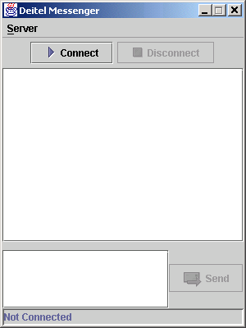
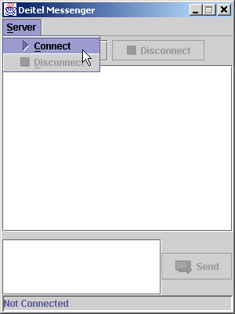
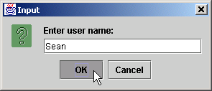
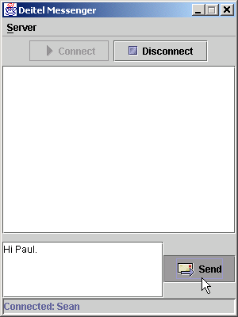
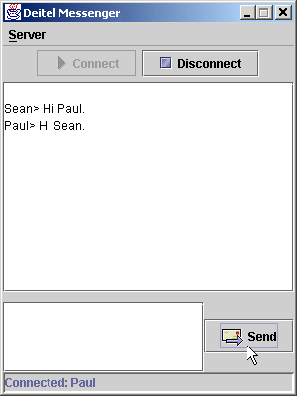
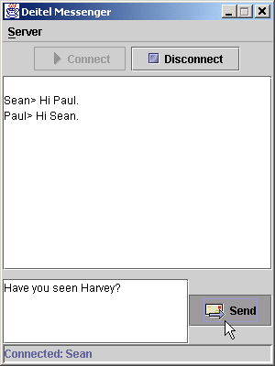
Program Output

Slide 103
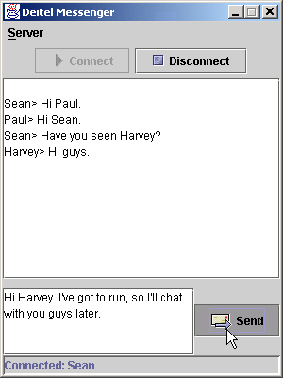
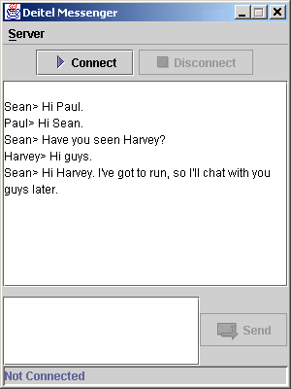
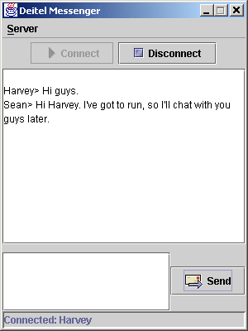
Program Output

Slide 104
17.11 (Optional) Discovering Design Patterns Used in Packages java.io and java.net
Abstract Factory design pattern
  Creational design pattern
  System determines subclass from which to instantiate objects at runtime
  Uses a factory object
    Uses an interface to instantiate object
  Example:
    java.net.SocketFactory creates SocketImpl object

Slide 105
17.11 (Optional) Discovering Design Patterns Used in Packages java.io and java.net
Decorator design pattern
  Structural design pattern
  Allows object to gain additional responsibilities dynamically
  Example:
    ObjectOutputStream writes objects to streams (bytes)
    FileOutputStream writes bytes to files
    We can “decorate” the ObjectOutputStream with FileOutputStream to write objects to files:
      output = new ObjectOutputStream(
      new FileOutputStream( fileName ) );

Slide 106
17.11 (Optional) Discovering Design Patterns Used in Packages java.io and java.net
Facade design pattern
  Structural design pattern
  Allows one object to represent a subsystem
  Example:
    Gas pedal is façade object for car’s acceleration subsystem
    java.net.URL is a façade object
      Can access InetAddress and URLStreamHandler objects through facade

Slide 107
17.11.3 Architectural Patterns
Architectural patterns
  Promote loose coupling among subsystems
  Specify all subsystems and how they interact with each other

Slide 108
17.11.3 Architectural Patterns (cont.)
Model-View-Controller architectural pattern
  Model
    Contains application data
  View
    Graphical representation of model
  Controller
    Input-processing logic

Slide 109
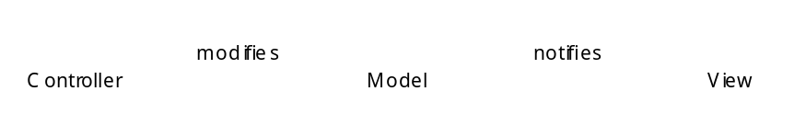
17.11.3 Architectural Patterns (cont.)
Fig. 17.22 Model-View-Controller Architecture.

Slide 110
17.11.3 Architectural Patterns (cont.)
Layers architectural pattern
  Divide system functionality into separate layers
    Each layer contains a set of system responsibilities
    Designers can modify layer without having to modify others
  Example:
    Three-tier architecture
      Information tier maintains application data (via database)
      Middle tier handles business logic
      Client tier provides user interface

Slide 111
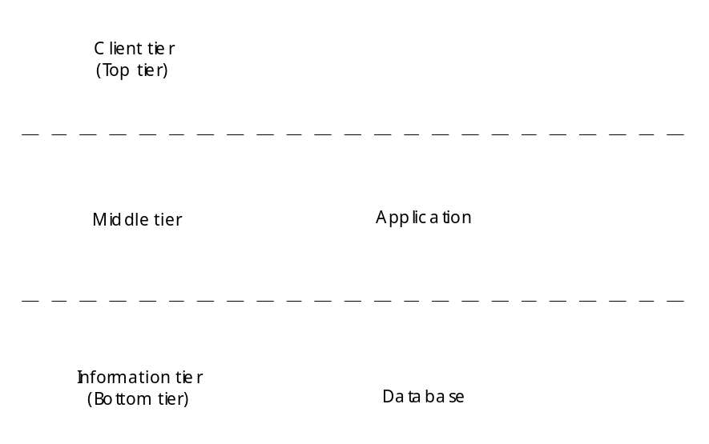
17.11.3 Architectural Patterns (cont.)
Fig. 17.23 Three-tier application model.

